Slide 1
Introduction to IBM Watson Studio

Slide 2
Unit objectives
Describe Watson Studio.
Identify industry use cases.
List Watson Studio offerings.
Create Watson Studio projects.
Describe Watson Studio and Spark environment.
Describe Watson Studio and Cloud Object Storage.
Explain Watson Studio high availability considerations.
Prepare and analyze data.
Use Jupyter notebooks.

Slide 3
Topics
Watson Studio overview
Watson Studio components
Jupyter notebooks

Slide 4
Watson Studio overview

Slide 5
What is Watson Studio?
Watson Studio provides the environment and tools for you to work on data to solve your business problems.
Analyze and visualize data, cleanse and shape data, ingest streaming data, and create and train machine learning models.
Collaborative platform:
Collaborators share data sets and computing resources
Simplified communication between different users and job roles
Tools: Data Refinery, Jupyter notebooks, RStudio, SPSS Modeler flows, Decision Optimization.
Integrated with:
Watson Knowledge Catalog
Watson Machine Learning
Cognos Dashboards
Notes:
Watson Studio is a collaborative platform for working on data. The collaborative platform enables the users, whether they are data scientists, data engineers, or application developers to share resources and work together seamlessly within the platform.
Watson Studio contains some open-source components such as Python, Scala, R, and Jupyter notebooks, and IBM added value components such as Watson Machine Learning, SPSS Modeler, Decision Optimization, AutoAI, and more.
References
Watson Studio on Cloud Pak for Data as a Service
https://dataplatform.cloud.ibm.com/docs/content/wsj/landings/wsl.html

Slide 6

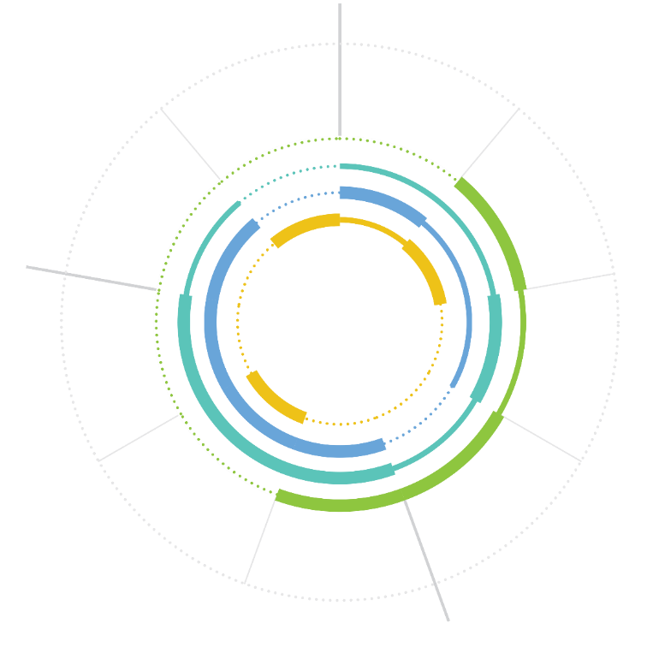



Correct tool for the correct job
OUTPUT
Data Engineer
INPUT
Designs how data is organized and ensures operability.
Deliver and Deploy Model.
Understand Problem and Domain.
Data Scientist
Communicate Results.
Import
Data.
Goes deep into the data to draw hidden insights for the business.
Watson Studio
Create and Build Model.
Explore and Understand Data.
Business Analyst
Works with data to apply insights to the business strategy.
Cognos Analytics
Evaluate.
Transform: Clean.
App Developer
Transform: Shape.
Plugs into data and models and writes code to build apps.
ANALYSIS
IBM Cloud
Notes:
Open-source tools give you a wide range of choices. The downside of having too many choices is knowing the correct one to choose. Essentially, you want to pick the correct tool for the correct job. Watson Studio is no exception.
Watson Studio is designed for a specific persona, but other personas can use it as it relates to their jobs.
Look at the diagram on the slide. Starting from the top and going clockwise, you have the input, analysis, and output phases. Within each phase are the objectives of that phase. Each objective can overlap between various user personas.
Look at the list of personas on the right side: the data engineer, the data scientist, the business analyst, and the app developer. Each persona has primary tools that help them do their job. For example, the data scientist's main tool is Watson Studio.
Also, a team might include different personas. Whatever the case is, you must decide what tool is correct for the job, regardless of the personas. The definitions of personas can vary between different companies and evolve over time.
In addition to the tailored interface of Watson Studio, collaboration ties the team and the organization together by enabling them to share projects, code, and ideas. Imagine a data engineer builds a new data source and shares that asset with the data scientist and the business analyst. The business analyst immediately builds the reports and dashboards that they need. The data scientist experiments with the data and builds a model that passes all the tests and can be used with new applications. The team can immediately share that model with the application developer, who deploys a new application by using the model. As this project progresses, the team members update and share their statuses with the team, asking questions and sharing ideas or requirements.
In this scenario, data and analytics development become a team effort and is no longer done in silos. Additionally, because these assets can be published, other departments can reuse these assets, making the entire organization more agile.

Slide 7



Industry use cases
Retail
Transportation
Shopping experience
Loss & fraud prevention
Task & workforce optimization
Pricing & assortment optimization
End-to-end customer experience
Operations planning & optimization
Predictive maintenance
Route and asset optimization
Banking
Media and Entertainment
Optimize offers & cross-sell
Risk management
Fraud and crime management
Financial performance
Audience & fan insight
Social media insight
Content demand forecasting
Marketing & advertising optimization
Manufacturing
Telco
Inventory optimization
Predictive maintenance
Health, safety, & environment
Production planning and scheduling
Subscriber analytics
IOT analytics
Proactive marketing
Network design
Notes:
Data science spans multiple industries, but you can see that data analysis that is applied to some of these use cases is not entirely new. In fact, organizations have been doing these types of activities for many years. The advantage that you have with Watson Studio is that you can easily collaborate with other data scientists by using well-known tools that are widely used in the industry.

Slide 8
Watson Studio offerings
Watson Studio on Cloud Pak for Data as a Service (CP4DaaS)
On public IBM Cloud.
https://dataplatform.cloud.ibm.com
Watson Studio on Cloud Pak for Data (CP4D)
Run on your own cluster: your hardware and network.
Same tools and features.
Watson Studio Desktop (local workstation):
Download and try on your desktop.
Notes:
Watson Studio is available in the following offerings:
Watson Studio on Cloud Pak for Data as a Service (CP4DaaS) on the public IBM Cloud. To use it, you must have an IBM Cloud account and create an instance of the Watson Studio service.
Watson Studio on Cloud Pak for Data (CP4D). This offering can be installed on a private cloud or on-premises on the organization’s servers. It includes the same tools and features that are available in Watson Studio on CP4DaaS.
Watson Studio Desktop is the local version of the tool that you install on your local machine. IBM Watson Studio Desktop is a desktop client tool for solving your business problems by analyzing data with artificial intelligence. With Watson Studio Desktop, you can prepare data and build models on your desktop with visual drag and drop tools.
┌ Note ─────────────────
Exercises of this course use Watson Studio on CP4DaaS (on IBM Cloud).
└────────────────────
References
Watson Studio on CP4DaaS
https://dataplatform.cloud.ibm.com/docs/content/getting-started/overview-ws.html
Watson Studio on CP4D
https://www.ibm.com/docs/en/cloud-paks/cp-data/4.0?topic=services-watson-studio
Comparison between Cloud Pak for Data as a Service and Cloud Pak for Data 4.0
https://dataplatform.cloud.ibm.com/docs/content/wsj/getting-started/compare-cpd.html
Overview of Watson Studio Desktop
https://www.ibm.com/docs/en/wsd?topic=overview

Slide 9
Watson Studio high availability (public cloud)
Designed for 24x7 availability: Continuous availability and continuous delivery
Backup and recovery:
Watson Studio is disaster resistant.
Notebooks in Watson Studio are stored in a three-way Cloudant cluster in multiple geographic zones.
Watson Studio provides integration with GitHub and an interface for downloading notebooks if the customer wants to use their own backup.
Notes:
Watson Studio is designed for 24x7 availability, that is, continuous delivery and availability. Features and updates are rolled out without downtime. Notebooks in Watson Studio are stored in a three-way Cloudant cluster in multiple geographic zones. Watson Studio also provides integration with GitHub so that you can manually download the notebooks if you want to use your own backups.

Slide 10
Watson Studio components

Slide 11
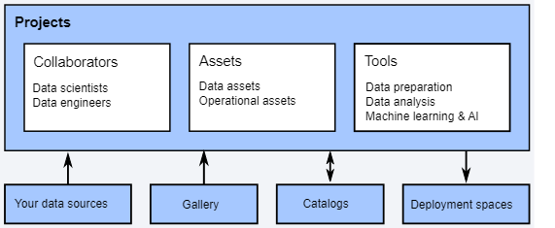
Projects
The architecture of Watson Studio is centered around the project.
Integrate collaborators, data and analytic assets, tools, Gallery resources, your own data, and so on to support finding insights for a well defined or narrow goal.
Notes:
The architecture of Watson Studio is centered on projects where everything is seamlessly integrated. You create and organize projects to suit your business needs. Projects consist of data and operational assets, collaborators, and tools.
Collaborators are the people on the team who work with the data. Data scientist tasks include analyzing data and building models. Data engineer tasks include preparing and integrating data. Collaborators can be added to projects as admins, editors, or viewers.
Data assets are your data that is either in uploaded files or accessed through connections to data sources.
Operational assets are the objects that you create, such as scripts and models, to perform actions on data
Tools are the software that you use to derive insights from data. These tools are included with the Watson Studio service on IBM Cloud:
Data Refinery
Jupyter notebook editor
Rstudio
SPSS Modeler
Decision Optimization model builder
Watson Studio projects fully integrate with catalogs of the Watson Knowledge Catalog service, and deployment spaces of the Machine Learning service.
References
Watson Studio on Cloud Pak for Data as a Service
https://dataplatform.cloud.ibm.com/docs/content/svc-welcome/wsl.html

Slide 12
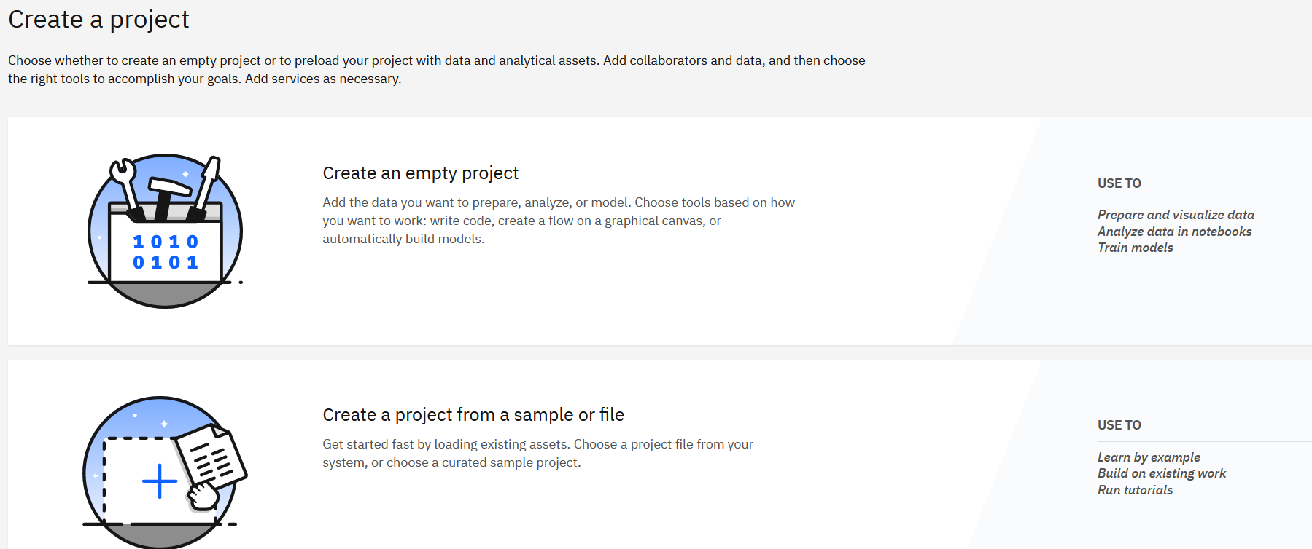
Creating a project
When you create a project in Watson Studio, you can create an empty project or preload your project with data and operational assets.
Notes:
When you create a project in Watson Studio, you can create an empty project or preload your project with data and analytical assets:
Create an empty project: Add the data that you want to prepare, analyze, or model. Choose tools based on how you want to work: write code, create a flow on a graphical canvas, or automatically build models.
Create a project from a sample or file: Get started fast by loading existing assets. Choose a project file from your system or choose a curated sample project.

Slide 13
Watson Studio and Cloud Object Storage
Projects require an object storage to store non-database assets.
An IBM Cloud Object Storage (COS) instance can be created when the project is created.
A project can be associated with an existing Cloud Object Storage instance.
Information that is stored in IBM Cloud Object Storage is encrypted and resilient.
Each project has its own dedicated bucket.
Buckets can be managed from the Watson Studio project interface.
Cloud Object Storage supports two APIs:
Swift API: Available through Watson Studio
Amazon Simple Storage Service (S3) API
Notes:
Object storage provides the space where non-database data for your project is stored. For example, files, notebooks, experiments, and Data Refinery flows can be stored in COS.
An IBM Cloud Object Storage instance can be created at project creation time, or a new project can be associated with an existing Cloud Object Storage instance.
Cloud Object Storage supports two APIs:
The Swift API, which is available through Watson Studio.
The S3 API, where you provide external credentials.
Information that is stored with IBM Cloud Object Storage is encrypted and resilient.
Cloud Object Storage uses buckets to organize the data. Each project has its own dedicated bucket.
The Cloud Object Storage can be managed from the Watson Studio project interface.

Slide 14
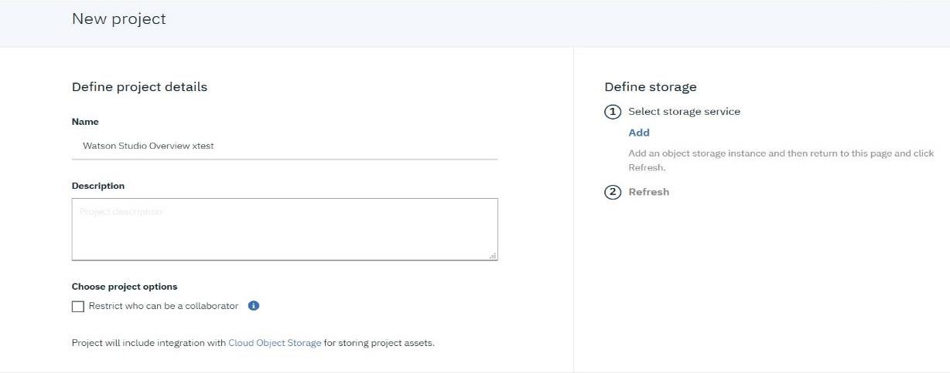
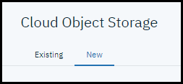
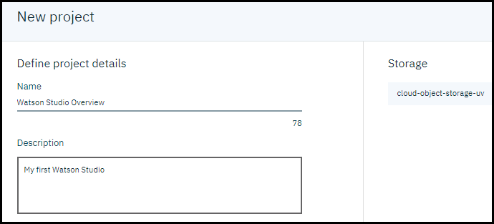
Creating a project and defining its storage
Notes:
Projects include integration with IBM Cloud Object Storage for storing project assets. When a project is created, a new Cloud Object Storage service is created to provide an unstructured cloud data store. It is also possible to associate a project with an existing Cloud Object Storage.
To create a new project:
Click + New.
Enter a name for the project.
In the Define storage pane, click Add.
Click Refresh.
The Cloud Object Storage service page with the New tab selected is displayed. Click Create.
Click Refresh in the project page.
The newly created Cloud Object Storage instance is associated with the project.
Click Create to create the project.

Slide 15
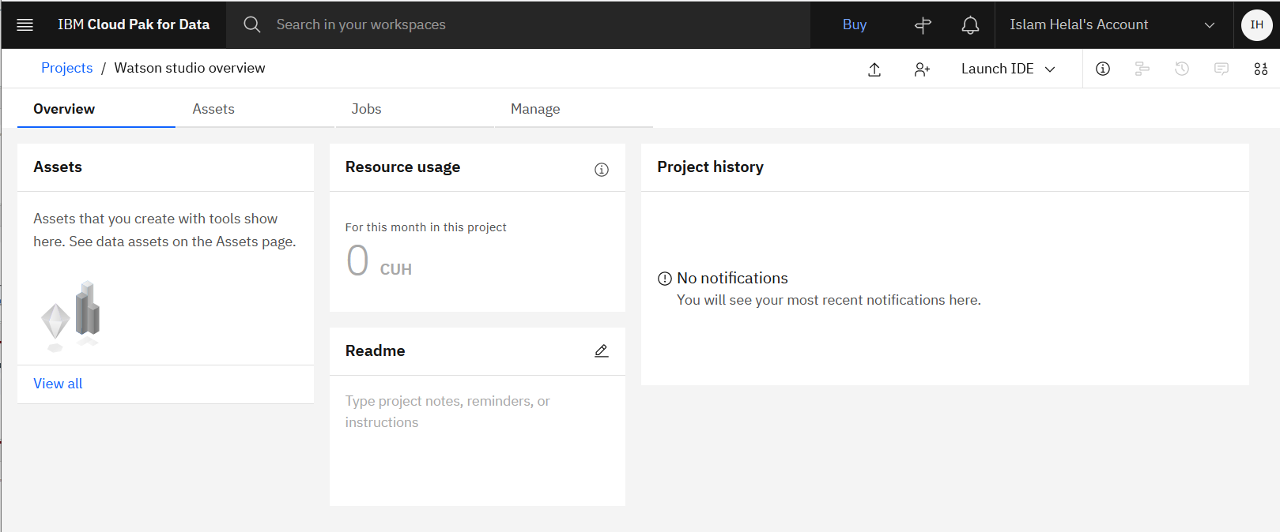
Watson Studio project tabs
Notes:
The Watson Studio project page includes tabs with specific information about the project. The following tabs are included:
Overview. Provides basic information about the project such as:
Assets
Resource usage
Project history
Readme
Assets. Lists all the different types of assets that you can add to you project such as:
Data assets
Models
Notebooks
Dashboards
Experiments
Modeler flows
Jobs. A job is a way of running assets, such as Data Refinery flows or notebooks in a project in Watson Studio.
From the Jobs tab of your project, you can:
See the list of the jobs in your project
View the details of each job. You can change the schedule settings of a job and pick a different environment definition.
Monitor job runs
Create job
Delete jobs
Reference:
Working in projects
https://dataplatform.cloud.ibm.com/docs/content/wsj/manage-data/manage-projects.html.

Slide 16
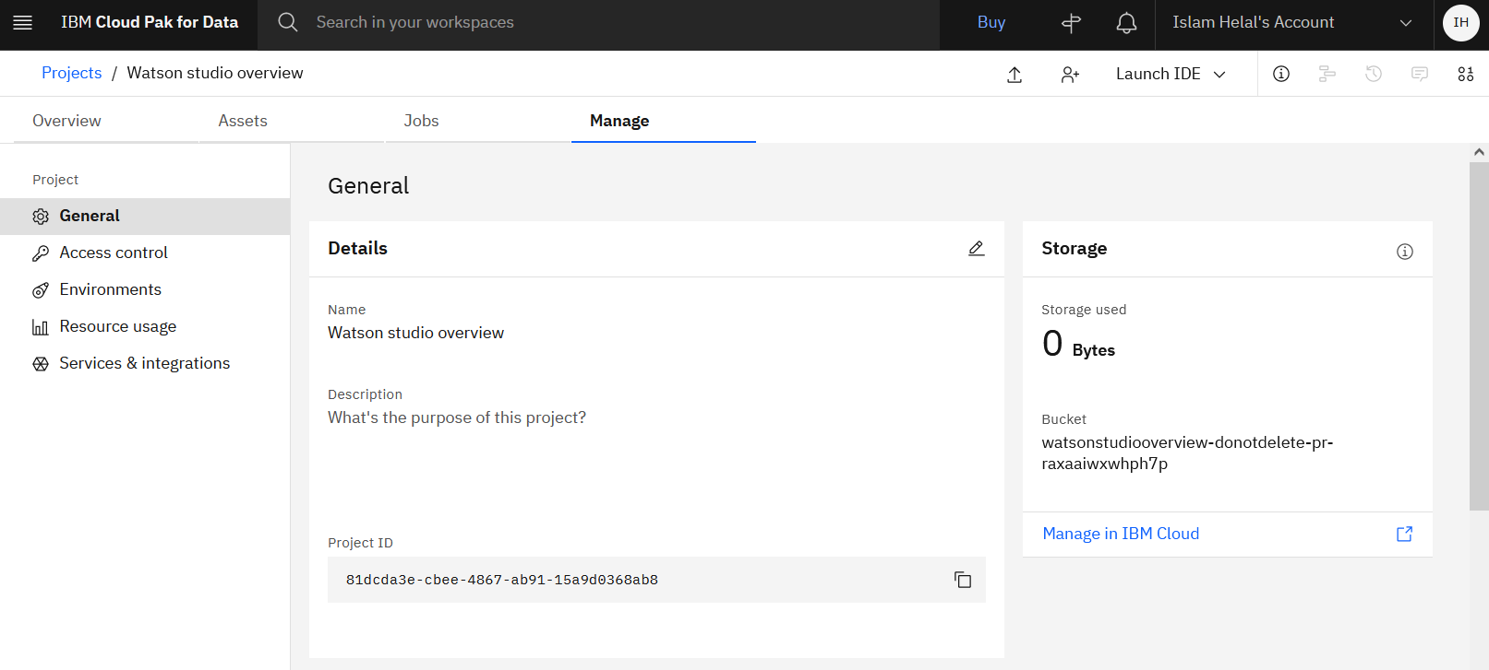
Watson Studio project tabs: Manage tab
Notes:
General. Project settings is the area to define key aspects of your project like its name and description. Use Settings to add tools and key services, check storage, and define access tokens.
Access Control. Here you can add and manage collaborators for your project.
Environments. In this tab, you can define the hardware size and software configuration for the runtime that is associated with Watson Studio tools. An environment definition defines the hardware and software configuration that you can use to run tools like notebooks, model builder, or the flow editor in Watson Studio. With environments, you have dedicated resources and flexible options for the compute resources that are used by the tools.
Resource usage. Contains resource usage details.
Services & integrations: Shows IBM Cloud services and third-party services associated with this project.

Slide 17
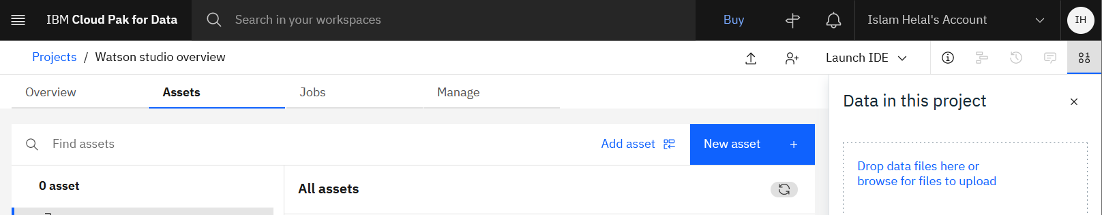
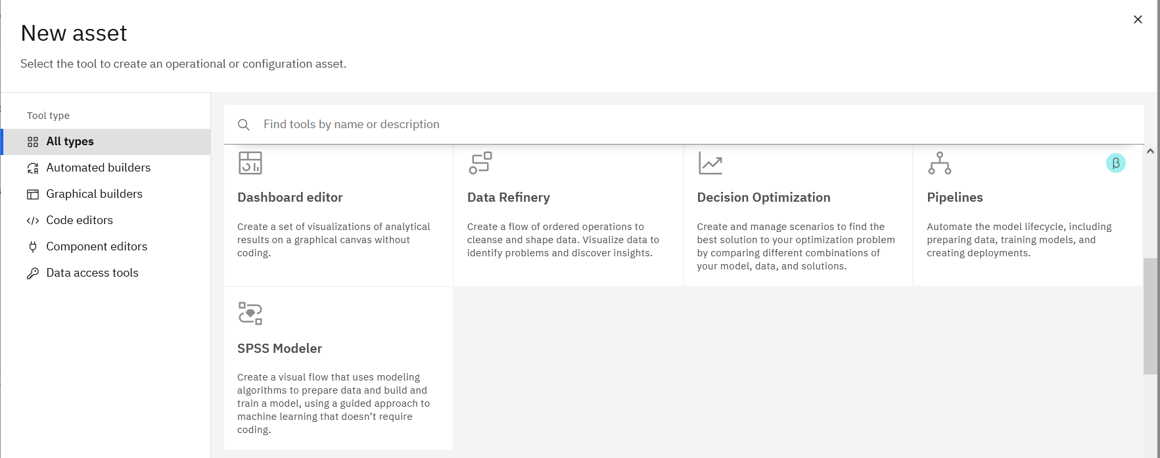
Assets
An asset is an artifact in a project that contains information, or metadata, about data or data analysis.
Notes:
An asset is an artifact in a project that contains information, or metadata, about data or data analysis.
Data assets are the types of assets that point to data, for example, a file or a data set that is accessed through a connection to an external data source.
Analytical assets are the types of assets that run code to analyze data.
An asset might have associated files or require specific IBM Cloud services. For example, many types of analytical assets require a service.
The information that you can view about an asset and the actions that you can perform on an asset vary by asset type. A few actions apply to all asset types, for example, you can create, edit the properties of, and remove or delete all types of assets. You can edit the contents of most types of assets in projects. For data assets that contain relational data, you can shape and cleanse the data with the Data Refinery tool. For analytical assets, you can edit the contents in the appropriate editor tool. In catalogs, you can edit only the metadata for the asset.
A new project has no assets. By default, the Data assets type is added with all project starters. To add other asset types to your project, click New asset +.
Reference:
Asset types and properties
https://dataplatform.cloud.ibm.com/docs/content/wsj/getting-started/assets.html

Slide 18
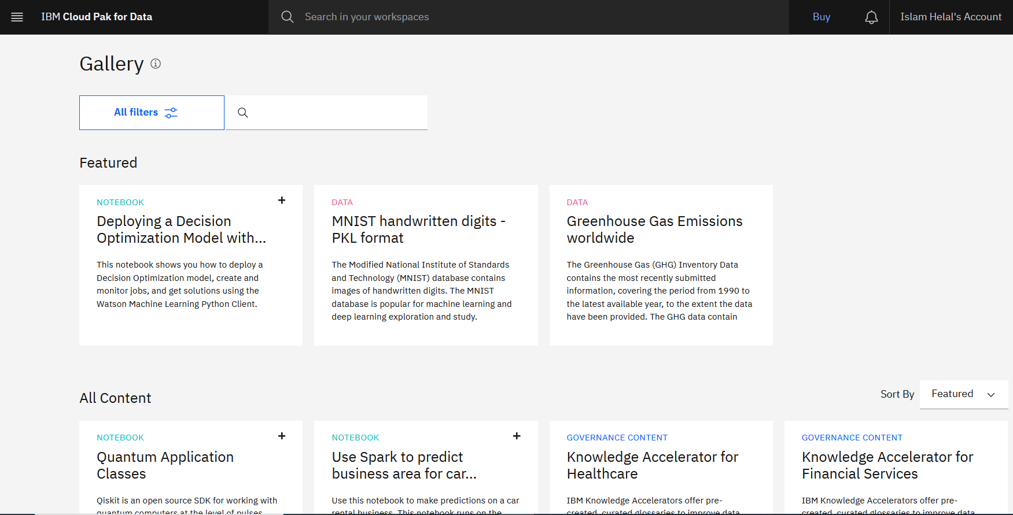
Watson Studio Gallery
Contains samples that you can use in your project:
Sample notebooks to learn new techniques or to use as templates.
Sample data sets to use in your project for analysis.
Notes:
The Watson Studio Gallery is a great place to get started. In the Gallery you can find open data sets that are ready to use, including local, state, and government data. You just download the data set and load it into your project.
The Gallery includes sample data sets and notebooks that apply to various topics such as transportation, science and technology, health, law and government, economy and business, and many more. You can add the data set or notebook to your project.
When you sig n into Watson Studio, scroll down in the home page to see the content that is most recently added to the Gallery. You can click Explore to browse the Gallery content from here. Alternatively, you can use the menu to go directly to the Gallery area where you find data sets and notebooks.

Slide 19
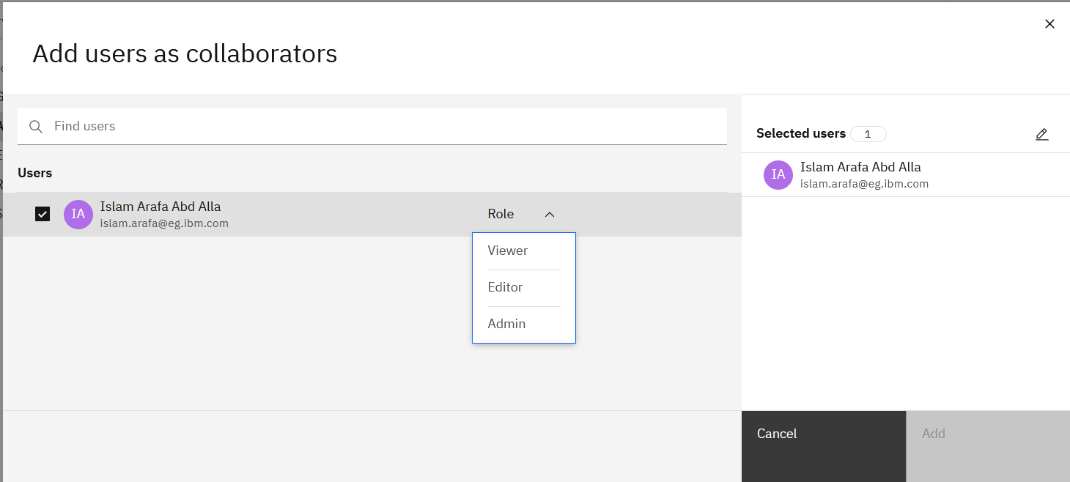
Collaborating in a project
Project collaborators share knowledge and resources.
Admin role is required to manage collaborators (add, remove, and edit).
Collaborators are added at the project level.
Only collaborators in a project can access the project’s data and notebooks assets.
Notes:
After you create a project, add collaborators to share knowledge and resources.
Project collaborators share knowledge and resources and help one another complete jobs. You must have the Admin role in the project to manage collaborators.
Only the collaborators in your project can access your data, notebooks, and other assets. Collaborators can be removed from a project or have their permissions changes.
To add collaborators to your project:
From your project, click the Manage>Access Control tab, and then click Add collaborators.
Add the collaborators who you want to have the same access level:
Type email addresses into the Find users field.
Choose the access level for the collaborators and click Add:
Viewer: View the project.
Editor: Control project assets.
Admin: Control project assets, collaborators, and settings.
Add more collaborators with the same or different access levels.
Click Add.
If the added users have existing IBM Cloud accounts with Watson Studio activated, they are added to your project immediately.
If an added user does not have an IBM Cloud account, the user receives an email invitation to create an IBM Cloud account and activate Watson Studio. When the user activates Watson Studio, the user can see your project and the user's status on your collaborators list changes from Invited to Active. If necessary, you can resend or cancel an invitation.
Reference:
Project collaborators
https://dataplatform.cloud.ibm.com/docs/content/wsj/getting-started/collaborate.html

Slide 20
Watson Studio and Spark
You need a Spark environment if:
Your notebook includes Spark APIs.
You create machine learning models or model flows with Spark runtimes.
You want to utilize parallel processing that is provided by the platform or by other services.
Spark environments are available under Watson Studio
Default environment templates are listed on the project’s Environments page.
Watson Studio users can create Spark environments with varying hardware and software configurations.
Notes:
Apache Spark is an open-source distributed cluster computing framework that is optimized for extremely fast and large-scale data processing. Spark provides a core data processing engine. Several libraries for SQL, machine learning, graph computation, and stream processing that is run on Spark and can be used together in an application. To learn more about Apache Spark, see documentation and examples at spark.apache.org.
All Watson Studio users can create Spark environments with varying hardware and software configurations. Spark environments offer Spark kernels as a service (SparkR, PySpark, and Scala). Each kernel gets a dedicated Spark cluster and Spark executors. Spark environments are offered under Watson Studio and like default environments, consume capacity unit hours (CUHs) that are tracked.
References
Predefined software specifications https://dataplatform.cloud.ibm.com/docs/content/wsj/analyze-data/pm_service_supported_frameworks.html

Slide 21
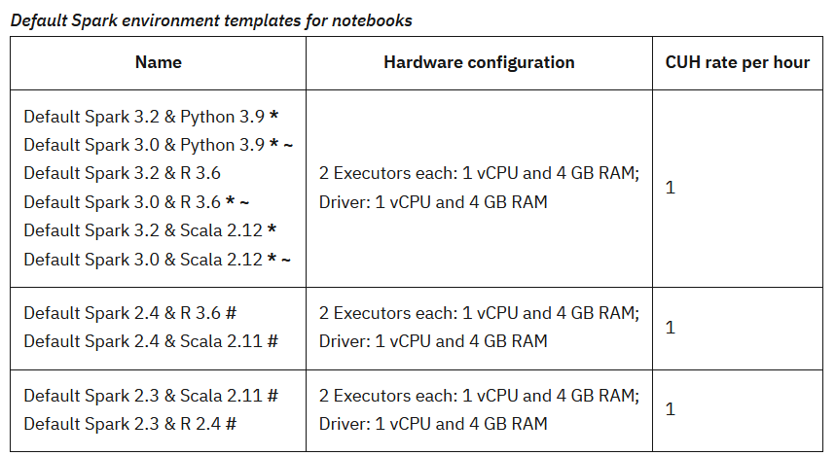
Spark default environments
Notes:
Spark environments offered under Watson Studio
The slide shows the default Spark environments definition under the project’s Environments tab.
You can select any of the default Spark environment templates for notebooks that are listed in the slide. These default environment templates are listed on the project’s Environments page.
* Indicates that the environment includes libraries from IBM Runtime 22.1.
~ Indicates that the environment is deprecated. Consider switching to a newer version as soon as you can.
# Indicates that the environment is in constricted mode. You can no longer create new notebooks with this environment.
Reference:
Default Spark environment templates
https://dataplatform.cloud.ibm.com/docs/content/wsj/analyze-data/notebook-environments.html#default-spark

Slide 22
Jupyter notebooks

Slide 23
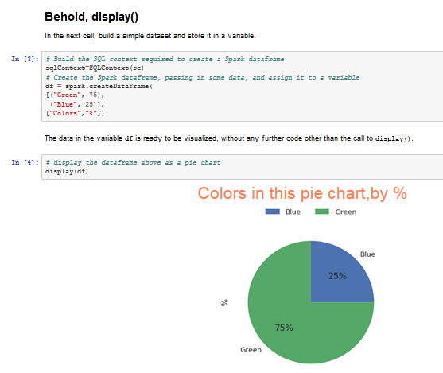
Jupyter notebooks overview
A web-based environment where you can run small pieces of code that process your data and immediately visualize the results.
Include all the building blocks to work with data:
The data
The code computations that process the data
Visualizations of the results
Text and rich media to enhance understanding
Other options:
Rstudio for statistical computing
Notes:
A Jupyter notebook is a web-based environment for interactive computing. You can run small pieces of code that process your data, and you can immediately view the results of your computation. Notebooks include all of the building blocks that you need to work with data:
The data
The code computations that process the data
Visualizations of the results
Text and rich media to enhance understanding
From markdown and live code to visualizations, notebooks include all of the building blocks you need to work with data and enhance your understanding.
You can use notebooks to add formatted text around executable code to describe what is being done and show the result, including graphics, concurrently.
Another popular environment for data science, statistical analysis, and graphic representation is provided by the R language. Watson Studio includes RStudio for people that prefer the R development environment.

Slide 24

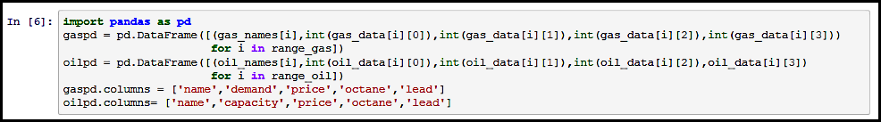
Parts of a notebook
Menu bar and toolbar
Action bar
Cells in a Jupyter Notebook:
Code cells
Markdown cells
Notes:
The menu bar controls most of the operations and settings for the notebook. Simple and common functions are supported through the menu bar.
From the action bar, you can select features that enhance notebook collaboration. From the action bar, you can:
Publish your notebook as a gist or to GitHub.
Create a permanent URL so that anyone with the link can view your notebook.
Schedule to run your notebook at a specific time.
Add a project token so that code can access the project resources.
View your notebook information. Change the name of your notebook by editing it in the Name field. If your notebook runs in an environment, you can view the environment details and runtime status.
Save versions of your notebook.
View and add data sources.
Post comments to project collaborators.
Integrate data into your notebook.
Find resources in the Gallery, for example, useful data sets.
Cells in a Jupyter notebook
A Jupyter notebook consists of a sequence of cells. The flow of a notebook is sequential. You enter code into an input cell, and when you run the cell, the notebook executes the code and prints the output of the computation to an output cell.
You can change the code in an input cell and re-run the cell as often as you like. In this way, the notebook follows a read-evaluate-print loop paradigm. You can choose to use tags to describe cells in a notebook.
The behavior of a cell is determined by a cell’s type. The types of cells include:
Code cells: They are the cells where you edit and run the code. The output of the cell appears beneath the cell. Tags can be used to describe the cell for code readability and maintainability. Cells can be rerun as often as you like.
Markdown cells are used to document and comment the process. You can use markdown cells to structure your notebook by using the markdown language. Images and file attachments can be added to the notebook by using the markdown cells.

Slide 25
Creating notebooks
Must have a project and a Spark service or environment.
Options to create a Jupyter notebook:
Blank, from a file, from a URL
Copy sample notebook from the Gallery
Specify a name for the notebook.
Notes:
If your notebook includes Spark APIs, or you want to create machine learning models or model flows with Spark runtimes, you need to associate the tool with a Spark service or environment. With Spark environments, you can configure the size of the Spark driver and the size and number of the executors.
When the project is set up, you can create the notebook by using one of these ways:
Blank
From a file
From a URL
You must specify a name for your notebook. You can create a notebook by importing a Python, Scala, or R notebook file (.ipynb) from your local workstation. You can also create a notebook from a URL by providing the URL.
Alternatively, you can copy a sample notebook from the Gallery to help you get started.

Slide 26
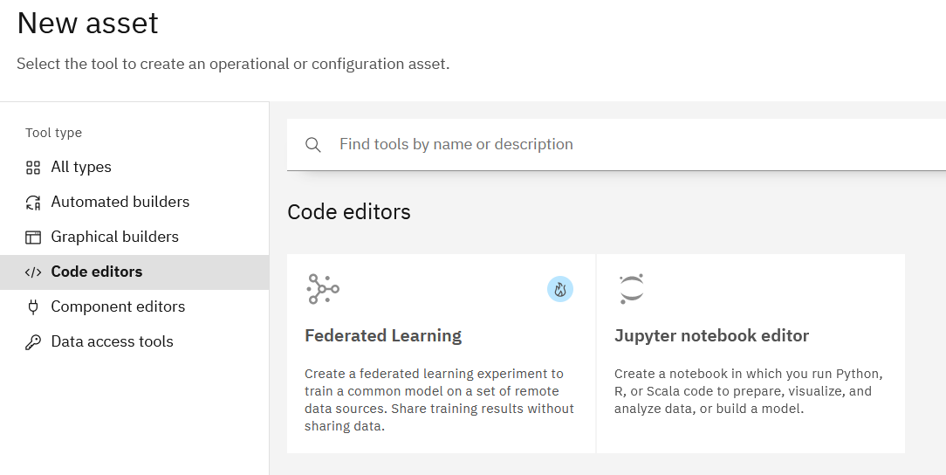
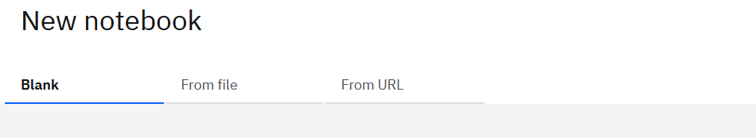
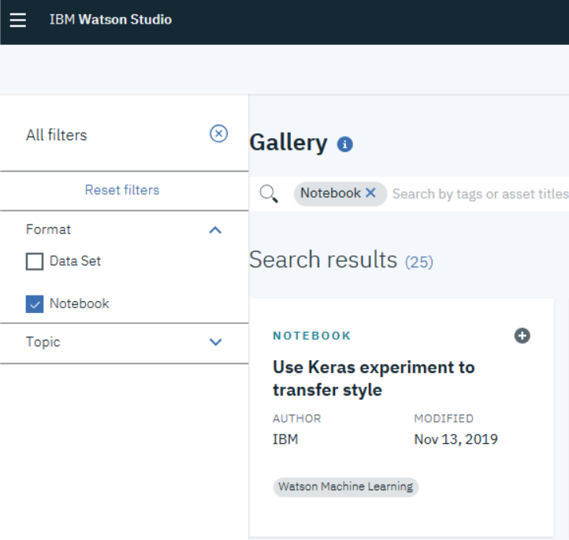
Creating notebooks (cont.)
From the project, click Assets> New Asset + > Code editors > Jupyter notebook editor
Select an option: Blank, From file, or From URL.
Copy sample from Gallery.
Notes:
Create a notebook file
To create a notebook file in the project:
From your project, click Assets> New Asset + > Code editors > Jupyter notebook editor
In the New Notebook page, specify the method to use to create your notebook. You can create a blank notebook, upload a notebook file from your file system, or upload a notebook file from a URL. The notebook that you create or select must be a .ipynb file.
Specify the language: Python, R, or Scala.
Specify the runtime environment. After you create an environment definition on the Environments page of your project, it appears in the list of runtimes that you can select when you create the notebook.
Click Create Notebook. The notebook opens in edit mode.
Copy a sample notebook from the Gallery
Sample notebooks from the Gallery are based on real-world scenarios and contain many useful examples of computations and visualizations that you can adapt to your analysis needs.
To copy a sample notebook:
Click Gallery from the Watson Studio menu, then filter for Notebooks to show only notebook cards.
Find the card for the sample notebook that you want and click the card. You can view the notebook contents to browse the steps and the code that it contains.
To work with a copy of the sample notebook, click the Copy icon. The New Notebook screen opens.
Choose the project for the notebook.
Specify the runtime environment. After you create an environment definition on the Environments page of your project, it appears in the list of runtimes that you can select when you create the notebook.
Click Create Notebook. The notebook opens in edit mode.

Slide 27
Coding and running notebooks
Import libraries:
Preinstalled from Python or R.
Install custom or third-party libraries for any language. For Scala, no libraries are preinstalled in the Spark service.
Load and access data:
Add a file from the local system to your object store.
Use a free data set from the Watson Studio home page.
Load data from a data source connection.
Prepare and analyze the data.
Collaborate with other project members or share outside Watson Studio.
Visualize the results.
Notes:
To code and run notebooks, complete the following steps:
Import the libraries that you need for the notebook. You can import preinstalled libraries if you are using Python or R. If you are using Scala, you must install the libraries manually, and they are available for the duration of that notebook.
Load and access the data. To load data into your own notebooks, you can choose one of these options:
Add a file from your local system to your object storage.
Use a free data set from the Gallery.
Load data from a data source connection, such as an external data source or another IBM Cloud service.
Prepare and analyze data
With the libraries and data loaded, you can start data analysis by preparing the data, analyzing the data, and making predictions. You can write your own code with Python functions to work with data and IBM Cloud Object Storage in notebooks.
Collaborate with other project members and share your notebook with people outside Watson Studio.
You can create a URL to share the last saved version of a notebook on social media or with people outside of Watson Studio. The URL shows a read-only view of the notebook. Anyone who has the URL can view or download the notebook. Whenever you save a new version of the notebook with the File > Save Version command, the URL shows the new version. The shared notebook shows the author of the shared version and when the notebook version was last updated.
Visualize the data. Use visualizations in your notebooks to present data visually to help identify patterns, gain insights, and make decisions. Many of your favorite open source visualization libraries, such as matplotlib, are pre-installed on Watson Studio. All that you have to do is import them.

Slide 28
Unit summary
Describe Watson Studio.
Identify industry use cases.
List Watson Studio offerings.
Create Watson Studio projects.
Describe Watson Studio and Spark environment.
Describe Watson Studio and Cloud Object Storage.
Explain Watson Studio high availability considerations.
Prepare and analyze data.
Use Jupyter notebooks.

Slide 29

Review questions
True or False: Watson Studio is designed only for the data scientist persona.
True or False: Object storage provides the space where unstructured data for your project is stored.
True or False: Collaborators can be given different access levels.
True or False: Collaboration within Watson Studio is an optional add-on component that must be purchased.
True or False: Watson Studio Gallery provides access to sample notebooks and data sets that you can use.

Slide 30

Review answers
True or False: Watson Studio is designed only for the data scientist persona.
True or False: Object storage provides the space where unstructured data for your project is stored.
True or False: Collaborators can be given different access levels.
True or False: Collaboration within Watson Studio is an optional add-on component that must be purchased.
True or False: Watson Studio Gallery provides access to sample notebooks and data sets that you can use.
Notes:
True or false: Watson Studio is designed only for the data scientist persona. False: The data engineer, the data scientist, the business analyst, and the app developer. Each persona has primary tools that help them do their job. For example, the data scientist's main tool is Watson Studio but other personas can use it as it relates to their jobs. . Also, there might be a team of different personas. Whatever the case is, you must decide what tool is correct for the job, regardless of the personas. The definitions of personas can vary between different companies and evolve over time.”
True or False: Object storage provides the space where unstructured data for your project is stored.
True or False: Collaborators can be given certain access levels. True: “Add collaborators to your project by using their email addresses. If they have an existing account on IBM Cloud, they are added immediately. Otherwise, they receive an invite to create a Watson Studio account. Choose the permissions for each collaborator. The Admin role can control project assets, collaborators, and settings. The Editor role can control project assets. The Viewer role can view the project. Collaborators can be removed from a project or have their permissions updated.”
True or False: Collaboration within Watson Studio is an optional add-on component that must be purchased. False: “Collaboration is a standard feature in Watson Studio.”
True or False: Watson Studio Gallery provides access to sample notebooks and data sets that you can use. True: “Watson Studio Gallery is a place where you can find and use open data sets that are ready to use, including local, state, and government data. You download the data set and load it into your project. If you are working within a notebook, you can add the data set to the project. Gallery is a great place to get started if you are exploring the data science space. There are sample notebooks to get you started or to learn about new libraries and use cases.”

Slide 31
Exercise: Getting started with Watson Studio

Slide 32
Exercise objectives
This exercise introduces you to the basic tasks that you will perform when using Watson Studio.
After completing this exercise, you should be able to:
Create a Watson Studio project.
Manage the project.
Assign collaborators.
Load a data set into the project’s object store.
Manage Cloud Object Storage.
Analyze data by using Watson Studio.
Use scikit-learn for linear regression.

